Slide 1
A complete job portal
JOB-AMIGO
Presented
By
Kommineni Siva Krishna
Thallapalli Ravisha
Bandaru Sarath Chandra
Yempalla Suresh Reddy

Slide 2
Contents
Introduction
Idea
Technologies Used
Implementation
Conclusion

Slide 3
Introduction
Developing an native mobile app for user friendly job search

Slide 4
IDEA
The application is designed for easy search of jobs for the job seekers based on the search criteria.
It is free of cost and benefits mainly the job seekers who are searching for the jobs with low income and low skills and profile also.

Slide 5
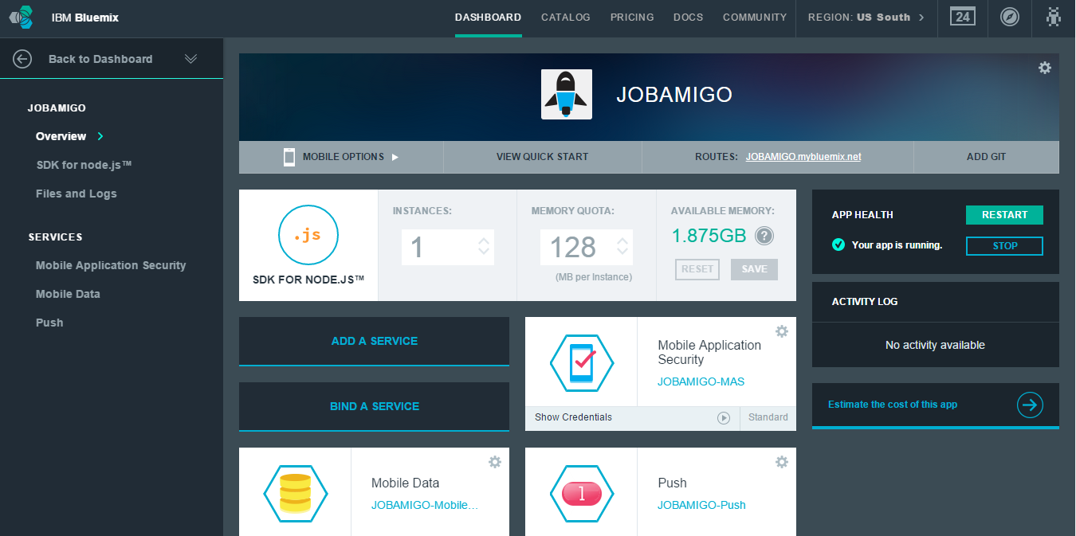
Implementation

Slide 6
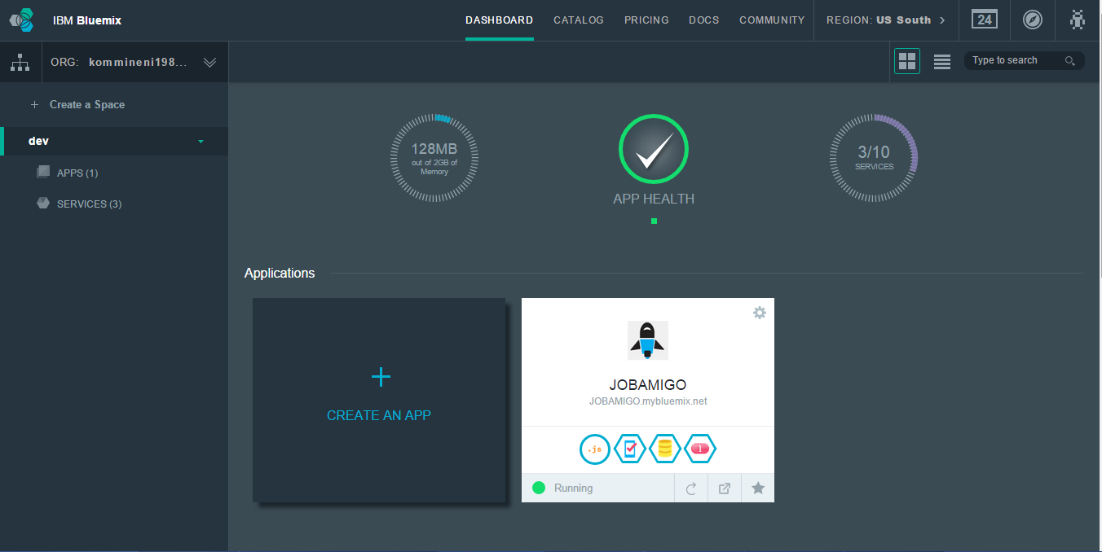
Cont..

Slide 7
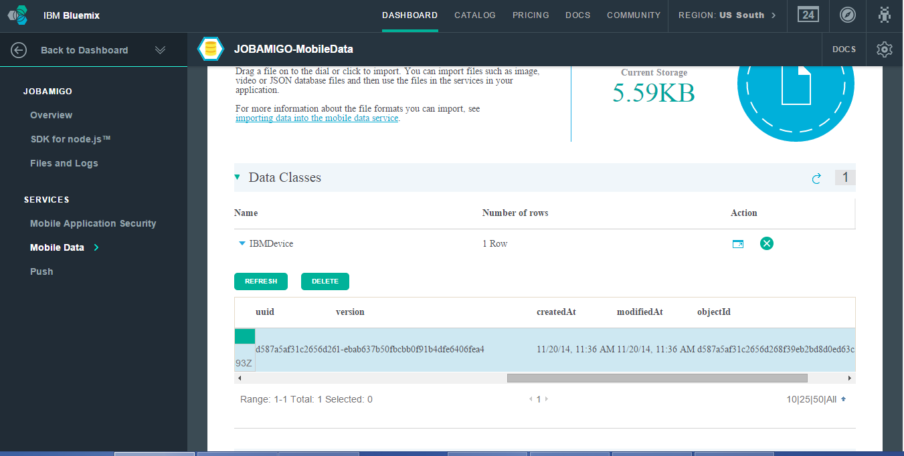
Cloud Data Storage

Slide 8
IMPLICATIONS,CHALLENGES,OPPORTUNITIES
Provides user friendly job search

Slide 9

CONCLUSION
Search jobs easily for the users.

Slide 11

Queries???

